Slide 1
Game of Decoys: Optimal Decoy Routing Through Game Theory
Milad Nasr, Amir Houmansadr
Summarized by Caleb Shere

Slide 2
Internet Censorship
Authoritarian countries like China, Egypt, and Saudi Arabia seek to control the information their citizens have access to.
In the case of China, this forbidden information includes political opinions not in line with the Communist Party.

Slide 3
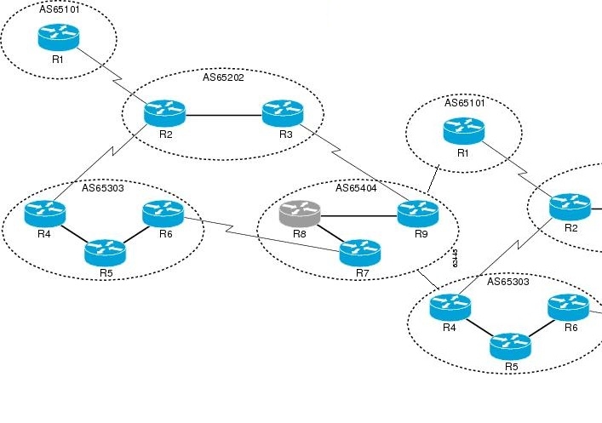
Internet Censorship
- The Internet is made up of Autonomous Systems (ASes)
that communicate with each other
- A country’s network may
consist of hundreds of ASes
Image by orosk.com

Slide 4
Internet Censorship
The country’s authorities seek to control what
comes in and out of their network…
Image by orosk.com

Slide 5
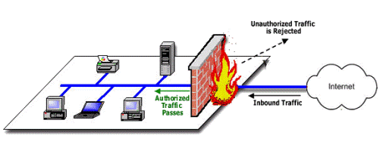
Internet Censorship
Our Threat Model: a simple IP firewall with a blacklist
Packets destined to or coming from certain IP addresses
are prevented from leaving or entering the network
Image by gohacking.com

Slide 6
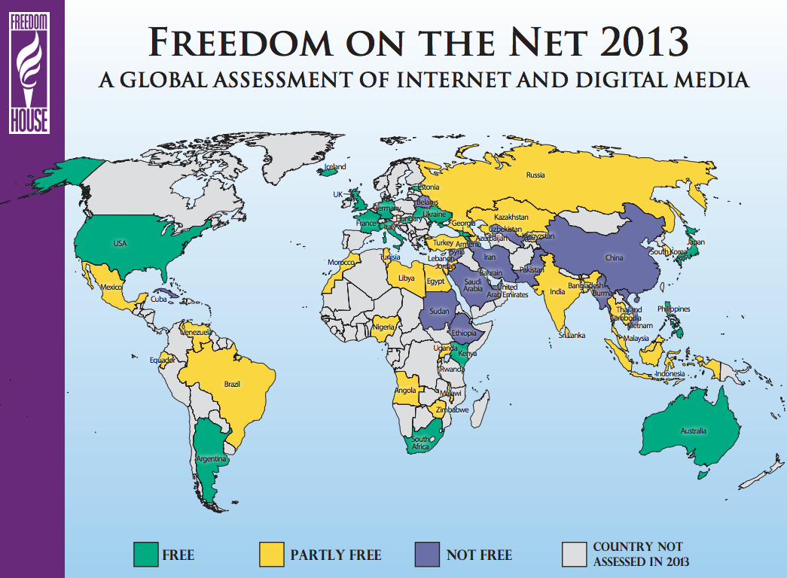
Internet Censorship around the World
Image by Freedom House

Slide 7
Outline
Decoy Routing – a method to bypass government censorship
Routing Around Decoys (RAD) – a censor’s response to decoy routing
The Game – pitting one against the other with game theory

Slide 8
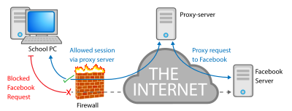
Decoy Routing - Background
Before decoy routing, the citizen might try to bypass a
firewall by using a proxy server
Image by Wikipedia

Slide 9
Decoy Routing - Background
The proxy server acts as an innocent-looking middle man
between the client and a forbidden site
Image by Wikipedia

Slide 10

Decoy Routing - Background
The problem with this method is that the censor can simply
block the proxy just like any other forbidden server
…unless there
are lots and lots
of them
Image by Wikipedia

Slide 11
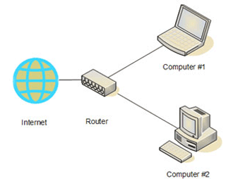
Decoy Routing – Background
A router is a device that connects
networks together.
It receives packets from a host
in one network and forwards
them to another network
according to the packet’s
destination
IP address
Image by ictlounge.com

Slide 12
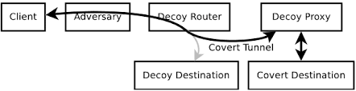
Decoy Routing - Background
Decoy Routing, Karlin et al, FOCI 2011
The decoy router takes Internet packets destined for a permitted
destination (decoy destination) and instead sends them to a proxy
server
The circumvention mechanism is placed in a router, rather than
a server. Why is this better?

Slide 13
Decoy Routing - Background
Reason 1: IP packets do not contain the addresses of the routers they will meet along the way, so the censor cannot block a router using his firewall

Slide 14
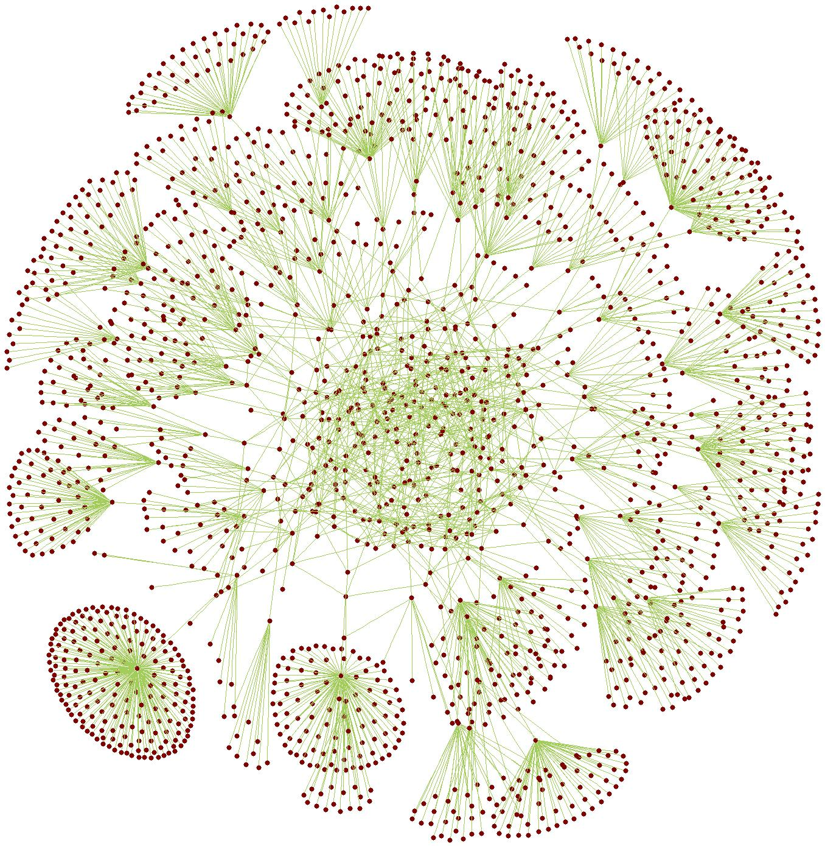
Decoy Routing - Background
Reason 2: The Internet has a lot of devices in it. A single router
may connect to millions of hosts --> makes millions of proxy servers!
Image by drdobbs.com

Slide 15
Decoy Routing – How it Works
Step 1: Configure a decoy router with the
cooperation of a free AS
Image by orosk.com

Slide 16
Decoy Routing – How it Works
Step 2: Establish a code between client and router
- Typically, this is done by inserting a specified string into a subtle location in a packet. E.g. in the TLS handshake or in an HTTP cookie.
- Or by port knocking (the client attempts to connect to a specified sequence of port numbers), or by sending a specified sequence of payload lengths

Slide 17
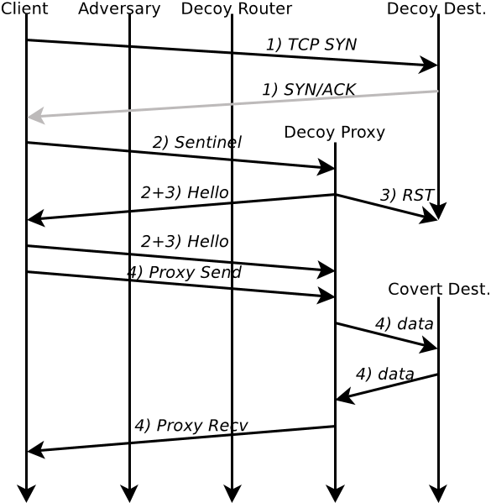
Decoy Routing – How it Works
Step 3: When the client wants to
connect to a forbidden site, he
must find a decoy router
With his sentinel (hidden string) in
place, he tries a number of different
decoy sites until he receives the Hello
message, indicating that he has
connected to a decoy router
Decoy Routing, Karlin et al, FOCI 2011

Slide 18
Decoy Routing – How it Works
Step 4: The decoy router connects the
client to the proxy server, which
continues the session with the client
while forging it to make it look like
a session with the decoy destination.
The client now has covert access to
a proxy server.
Decoy Routing, Karlin et al, FOCI 2011

Slide 19
Routing Around Decoys (RAD)
3 Step Process:
Detect that decoy routing is occurring
Determine where the decoy router(s) are
Route around the decoys

Slide 20
RAD Step 1 - Detection
The censor can compare the data of the route the packet
says it is taking versus the data of the route it is actually
taking.
For instance, if packets of 500 B are going to and from site X
but the censor knows that the maximum packet size on the
route to X is only 400 B, then decoy routing is probably
occurring (the packets aren’t actually going to X!)

Slide 21
RAD Step 2 - Discovery
Exactly like the client, the censor probes paths until he
receives the Hello message. But for the censor, it is not
enough to find a route with a decoy router. He must also
find which AS the router is in.
Probe intersecting routes
to isolate the decoy AS

Slide 22
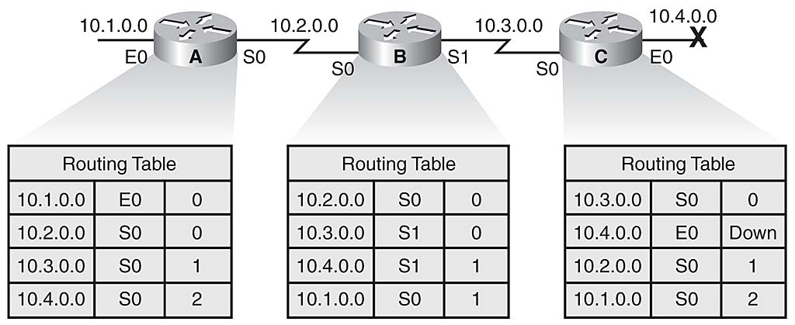
RAD Step 3 – Route around decoys
Routers collect route information in their routing tables. They choose the best route for a packet based on the AS’s routing policy defined in the Border Gateway Protocol (BGP).
Image by networkworld.com

Slide 23
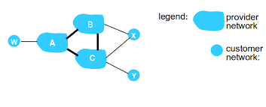
RAD Step 3 – Route around decoys
The “best” path will depend on factors like how much time the path
will take as well as the AS’s relationship with other ASes on the path.
Image by Jacob Aae Mikkelsen, University of Southern Denmark

Slide 24
RAD Step 3 – Route around decoys
The censor changes what is considered the best path by configuring
his routers to choose paths that avoid decoy routers.
Image by networkworld.com

Slide 25
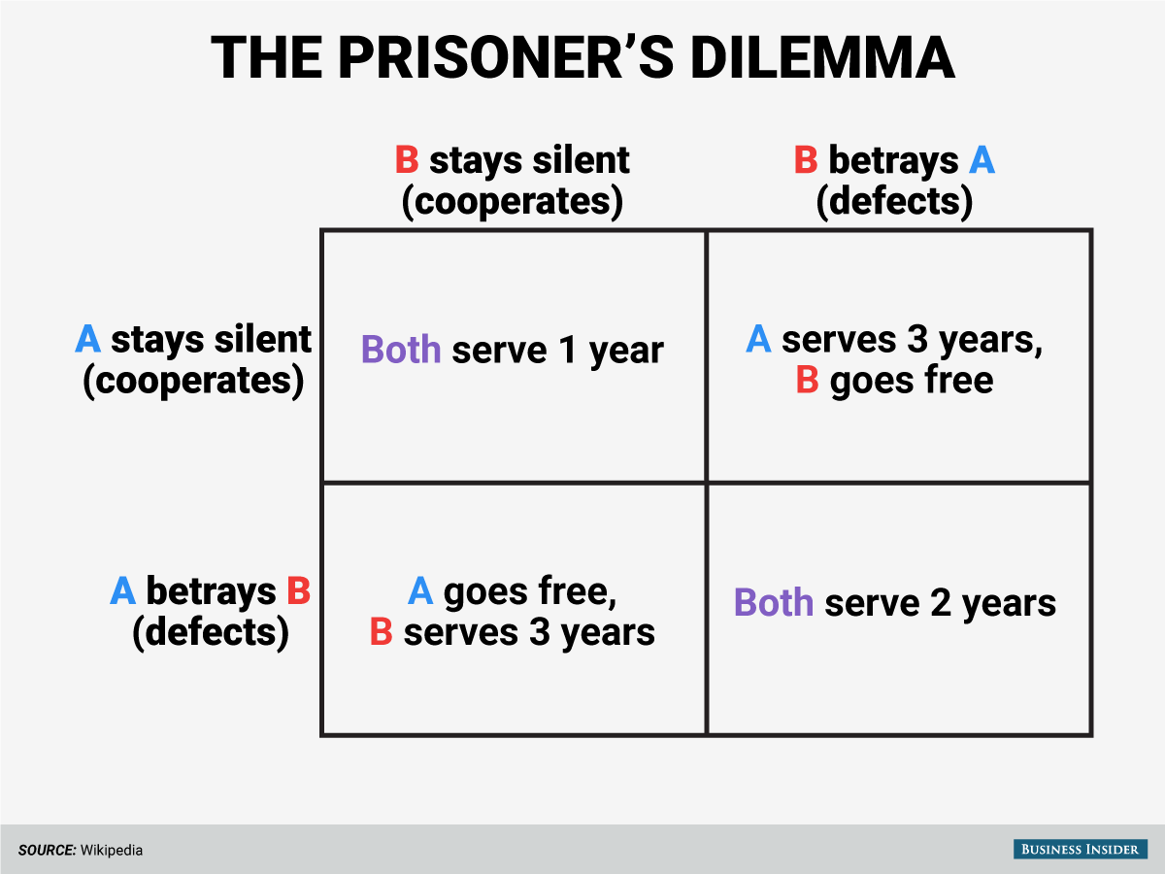
Game Theory
Image by Business Insider

Slide 26
Game Theory
Game Theory studies the interactions of rational individuals each trying to achieve their own goals.
A game has:
Players – the rational decision makers
Actions – what actions the players are permitted to take
Consequences – negative results of the actions
Payoffs – positive results of the actions

Slide 27
The Game – Players
1. censor – a governing entity that seeks to censor its citizens’ Internet access
2. decoy – a corporation that provides decoy routing service to the people of censor’s country. decoy will pay money to ASes outside of censor’s country in order to deploy decoy routing in them.

Slide 28
The Game – Actions
Censor:
censor makes one of two choices for every pair (AS_{i}, AS_{j}) where AS_{i} is in the censor’s country and AS_{j} is out:
1. use the BGP best route from AS_{i} to AS_{j}
or
2. use alternative (avoiding decoy router) route to get from AS_{i} to AS_{j}
His action is the set of all these choices:
A_{c} = {a(P_{i,j}) | for all pairs of censored and free ASes}

Slide 29
The Game - Actions
Decoy:
decoy’s action is the set of ASes in which he deploys a decoy router.
A_{d} = {AS₁,…,AS_{k}} where all of AS₁,…,AS_{k} are free ASes.

Slide 30
The Game - Consequences
Censor:
As a result of RAD, the censor faces two general costs:
Connectivity (C₁) – changing routes may result in blocking additional sites. There may not exist an alternative path that reaches every permitted site!
Cost (C₂) – avoiding decoy routers may force the censor to use more expensive paths (e.g. one that contains a provider AS)

Slide 31
The Game - Consequences
Decoy:
decoy’s cost is the sum of all the money he pays to each of AS₁,…,AS_{k} to set up a decoy router in that AS.
F = decoy’s budget
C_{decoy} = total cost for decoy
decoy is confined by the constraint: C_{decoy} <= F

Slide 32
The Game - Payoffs
For both players, the payoff is measured by the amount of censorship that remains at the end of the game. Censor wants more censorship, and decoy wants less.
We measure the amount of censorship with the censorship metric (denoted S).

Slide 33
Censorship Metric
1 indicates complete censorship (what censor wants). 0 indicates complete freedom (what decoy wants).
Let D quantify the amount of decoy routing deployed by decoy. Let P quantify the total amount of Internet traffic from the censored country to outside of it.
Then S = 1 – D/P

Slide 34
Utility Functions
The utility function of a player quantifies the player’s overall satisfaction and is expressed in terms of both the consequences and the payoffs.
Censor: U_{censor} = S * B₀ – (C₁B₁ + C₂B₂)
where (B₀,B₁,B₂) is the censor’s profile.
B₀ = how much censor cares about S
B₁ = how much censor cares about C₁ (connectivity loss)
B₂ = how much censor cares about C₂ (monetary cost)

Slide 35
Utility Functions
decoy:
U_{decoy} = 1 – S subject to C_{decoy} <= F
In the game, each player will aim to take the optimal action that maximizes his utility function.

Slide 36
Strategies
censor:
The original authors assume all of censor’s choices to be independent of each other. So for each pair (AS_{i}, AS_{j}), censor fixes the actions for every other pair and makes his choice (keep BGP or change route) like this:
if “keep BGP” results in a higher U_{censor}
keep BGP
else
change route

Slide 37
Strategies
decoy:
decoy wants to find the set of ASes A such that the total cost of A does not exceed F and the benefit gained by A is maximal.
This problem is NP-hard, but there is a known greedy approximation algorithm…

Slide 38
Strategies – decoy’s algorithm
A_{d} = {}
A’_{d} = {}
while C_{decoy} < F:
Sort ASes by how much each would contribute to circumvention (circumvention = 1 – S)
Add to A_{d} the AS with the highest contribution
Remove all routes that contain the selected AS
while C_{decoy} < F:
Sort ASes by how much each would contribute to circumvention divided by its cost
Add to A’_{d} the AS with the highest circumvention-cost ratio
Remove all routes that contain the selected AS
if U_{decoy}(A_{d}) > U_{decoy}(A’_{d})
return A_{d}
return A’_{d}

Slide 39
Simulating the Game
Main variables in the simulations are:
1. Size of decoy budget
2. Nature of censor’s profile
Also based on real countries China, Syria, Saudi Arabia, and Venezuela

Slide 40
Simulating the Game
 | B₀ | B₁ | B₂
T₁: QoS-cautious, wealthy | L | H | L
T₂: QoS-cautious, poor | L | H | H
T₃: QoS-ignorant, poor | H | L | H
T₄: Irrational | H | L | L
The various censor profiles to be used in the game.
H = high, L = low, QoS = quality of service.

Slide 41
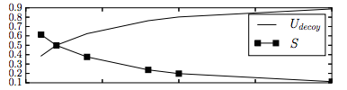
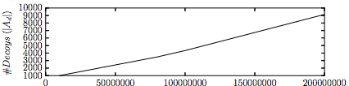
Simulating the Game – impact of decoy budget
Size of budget
Size of budget
Impact of decoy’s budget on decoy’s utility function (top) and on
the number of decoy routers deployed (bottom). Both figures
from Game of Decoys, Nasr and Houmansadr, ACM, 2016.

Slide 42
Simulating the Game – impact of censor profile
 | C₁ | C₂ | Cen. Metric | # decoys
T₁: QoS-cautions, wealthy | 0.000 | 0.087 | 0.277 | 2789
T₂: QoS-cautious, poor | 0.000 | 0.009 | 0.229 | 2706
T₃: QoS-ignorant, poor | 0.782 | 0.009 | 0.949 | 2710
T₄: Irrational | 0.799 | .093 | 1.000 | 2702
Impact of the censor profile on the costs incurred by the censor (C₁ and C₂), on the censorship metric, and on the number of decoys deployed. These results used China as the censor and a fixed decoy budget.

Slide 43
Simulating the Game – comparing countries
 | C₁ | C₂ | Cen. Metric | # decoys
China | 0.000 | 0.087 | 0.277 | 2789
Venezuela | 0.002 | 0.127 | 0.210 | 1450
Saudi Arabia | 0.002 | 0.161 | 0.197 | 1853
Syria | 0.003 | 0.011 | 0.101 | 544
Comparing various countries, using profile T₁ and a fixed
decoy budget

Slide 44
Conclusions
Good news, considering that RAD was previously thought to be a sure defense against decoy routing
Effective circumvention is within reach, particularly against a censor who wishes to avoid QoS damage
Less cautious censors can still maintain a high censorship metric, and an irrational censor (T₄) can still achieve complete censorship – but at great cost

